Slide 1

AMS 101th Annual Meeting January 9-15, 2021
Session: 19th Symposium on the Coastal Environment
NOAA’s Coastal-Act: The Parcel-Scale Wind Downscaling Modeling & Validation for 2018 Hurricane Florence
Anil Kumar¹, Avichal Mehra², Geoff DiMego¹, Arun Chawla², Zaizhong Maa1, 3Jack Kain², Andre Vanderwesthuysen¹, Saeed Moghimi³, Ed. Myers³, Sergey V.V.³
1 I. M. System Group at EMC/NCEP/NOAA, College Park, MD USA
2 Enviromental Modeling Center (EMC), NOAA’s National Centers for Environmental Prediction (NCEP), College Park, Maryland, USA
3CSDL/NOS/NOAA
1

Slide 2
Overview
Coastal-Act project overview
Wind Downscaling modeling framework
Implementation of High-Resolution datasets
Storm surge or inundation data integration
Hurricane Florence (2018)-Analysis
Conclusions

Slide 3
WIND ANALYSIS DOWNSCALING COMPONENT
(COASTAL) Act requires a wind analysis and to estimate the strength and timing of damaging winds at a given, “parcel-scale (10-30 meters)” over-land location in the area impacted by the tropical cyclone and to drive surge and wave models for estimating the water damage. And this can be done using LES.
The Consumer Option for an Alternative System to Allocate Losses (COASTAL) Act ‹#›‹#›

Slide 4
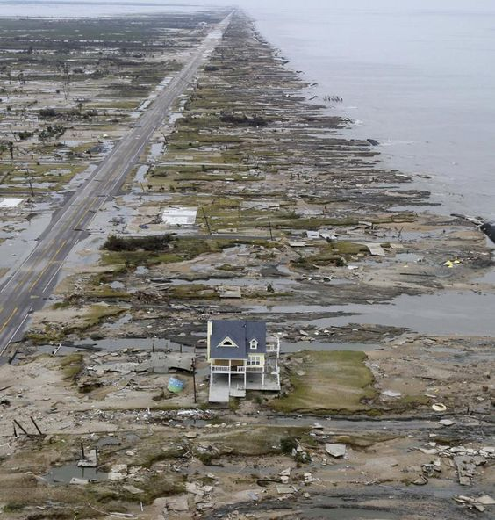
What is LES mode?
Running the WRF at high resolutions with the PBL scheme turned off and full diffusion turned on. The effects of sub-grid scale turbulence on the state variables is no longer parameterized.
Why Run in LES mode?
Capture a very turbulent or small scale phenomena
Capture all scales of turbulence >= model grid and their effects implicitly instead of parameterizing them with a PBL scheme
Run a high resolution run (<500m)
Loss of faith in the current WRF PBL parameterizations
Resolved winds at 10 to 30 meters spatial scale and at higher temporal resolution

Slide 5
COASTAL-Act Model experiment design
HWRF FORCINGS
(DA, ensemble )
LANDUSE (30-METER) 40 CATEGORIES NLCD(2011)
ELEVATION- USGS (2013) 1/3
arc-sec, 10-METER RES
WPS
SYSTEM
2D Surface winds, sfc pressure
From URMA/RTMA
Hourly
NUDGING
WATER INUNDATION
Max water surface elevation from ADCIRC model
(Time-Dependent)
Urban processes Module
(activated)
OUTPUTS (Surface) 15 mins average
Sfc Wind Speed Max (m/s), U10 & V10 Time of Max Sfc Wind speed, Mean wind speed 6. Standard Dev. Wind Speed, Mean SLP, 30-meter LANDUSE, 10-meter ELEVATION TERRAIN, Water Inundation mark
Fine simulation WRF-LES
(10-30 meter)
OUTPUTS (ATMOSPHERE) 15 mins average
1. Wind Speed Max (m/s) 2. Max Updraft Helicity 3. Updraft Helicity 4. Max Z-wind updraft 5. Max Z-wind downdraft 6. Mean Z-wind 7. Max col integrated Graupel

Slide 6
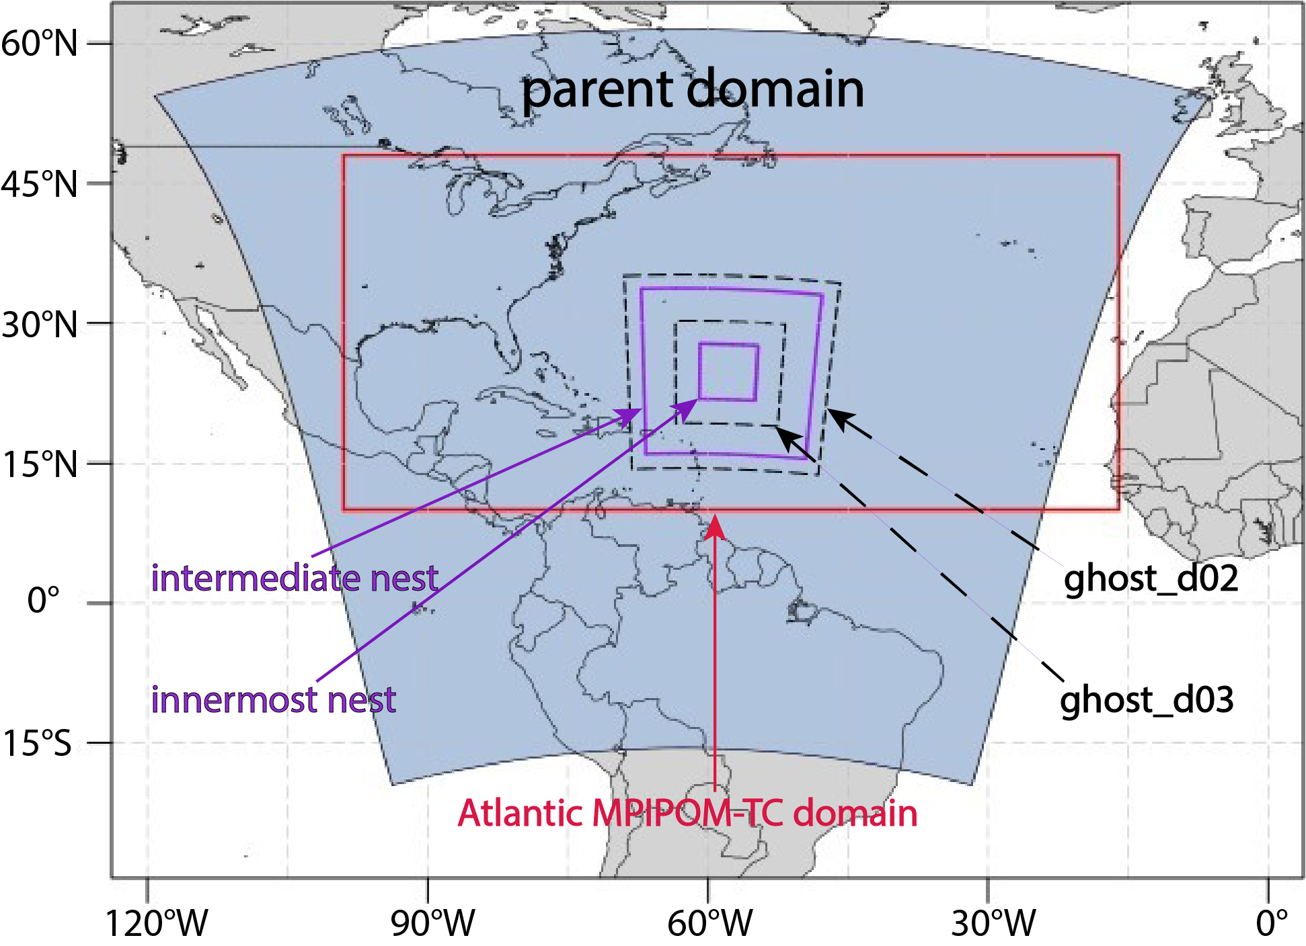
Operational HWRF v12 (Hurricane Weather Research and Forecast) System
HWRF continuously improved in the past decade through support from HFIP
Successful community modeling approach for accelerated transition of research to operations
Three nested domains at a horizontal resolution of 13.5/4.5/1.5 kms
Formal vortex initialization and GSI-based data assimilation
Actively coupled to Ocean models in all global basins
Actively coupled to Wave model (WW3) in NHC basins
Inner-core DA including real-time data from recon missions (TDR, dropsondes, SFMR etc.)

Slide 7
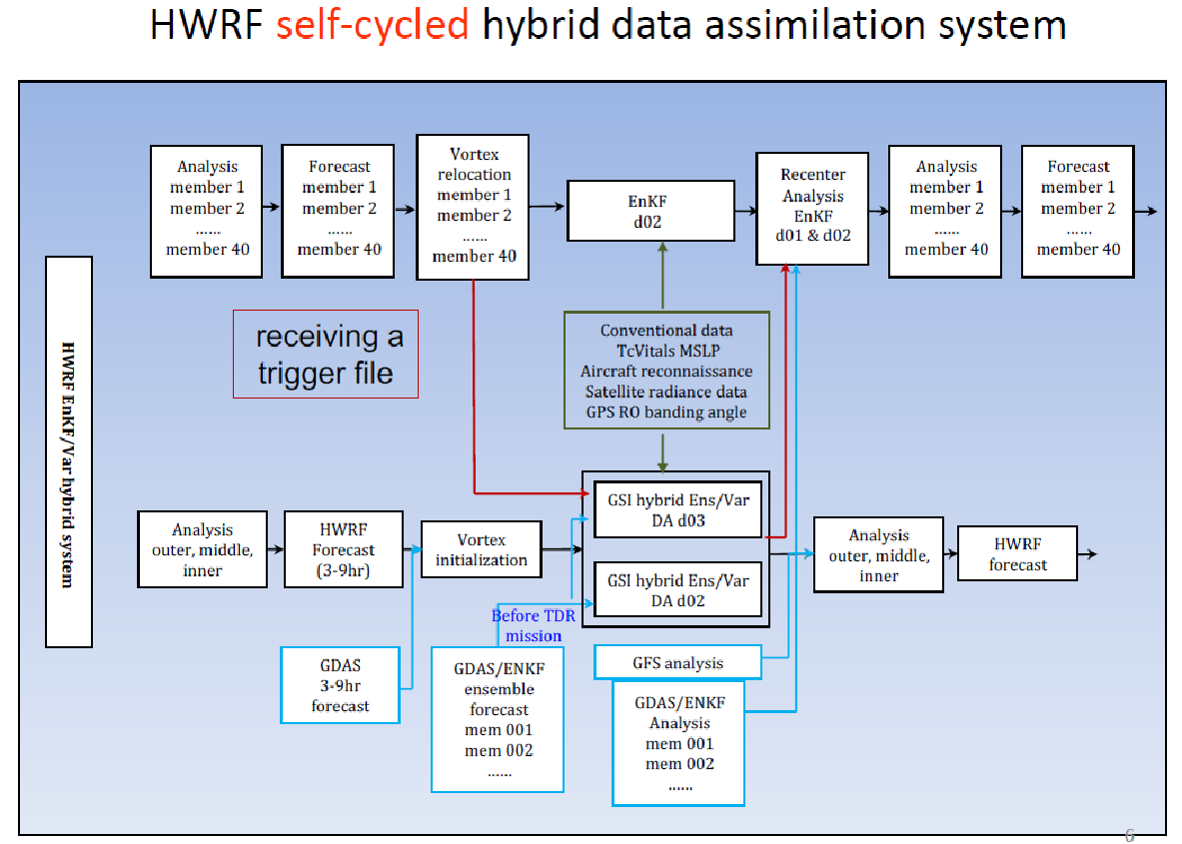

Slide 8

URMA Wind Analysis Workflow
Acquire database
Pre Processing
Model Run
HRRR/RAP
Prepbufr / Smartinit
URMA-GSI [2D-Var]
And post analysis
HWRF
Blending
SFMR
Obs processing
Observation
Output Validation
CWWED
CWWED
Feed the output to Downscaling
NCEP Data Tank

Slide 9
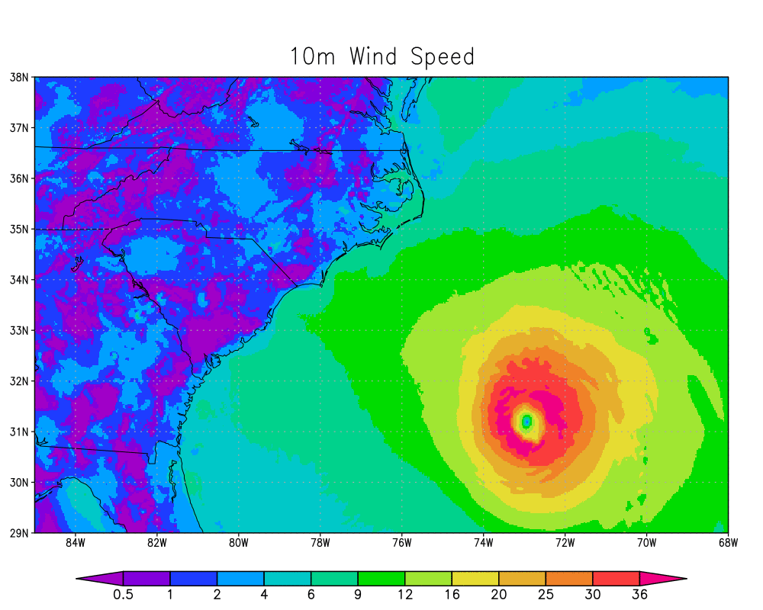
Florence URMA wind analysis
Workflow for wind and pressure analysis is set
Use of HRRR and HWRF on test
Addition of SFMR (test runs ongoing)
Input processing
Output Validation is ongoing
Interface to CWWED coupling is planned
10m Wind speed Florence 2018090823-2018091523

Slide 10
Wind Downscaling Workflow
Shell Scripting Module
Shell scripting( Update inundation hourly)
Acquire database
WRF Pre Processing
Model Run
ADCIRC
INUNDATION
1-D Data Regriding on to WRF Grid using Interpolation method using ESMF_Regrid
High resolution Landuse/Topography
Geogrid.exe
WRF-LES
10-30meter Parcel scale simulation
HWRF
Ungrib.exe
URMA/RTMA
Metgrid.exe
Observation
Output Validation
CWWED
CWWED
Output to ADCIRC/WAVEWATCH
NCEP Data Tank

Slide 11
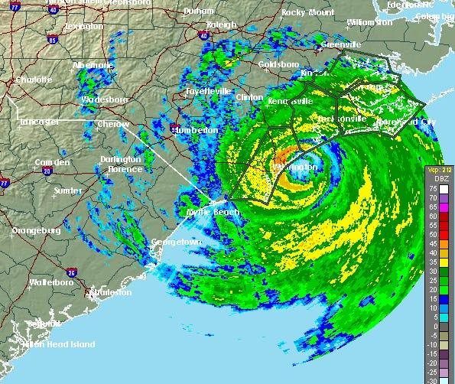
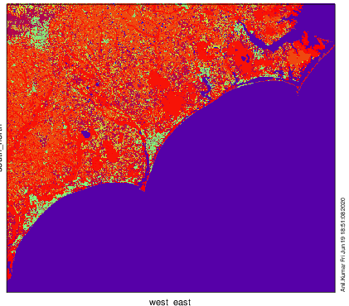
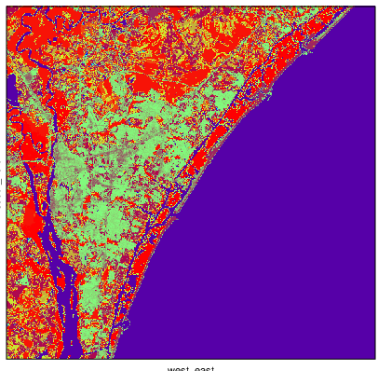
Downscaling Nested Domains WRF-LES
(10-30 meter) For Hurricane Florence 2018
Simulation type | PBL treatment | dx, dy (meters) | Grid Points
D1-mesoscale | YSU | 400 | 702 x 618
D2- microscale | LES | 90 | 889 x 850
D3-microscale | LES | 30 | 1165 x 1113
DOM1
DOM3 (30 meter)
DOM2
DOM3

Slide 12
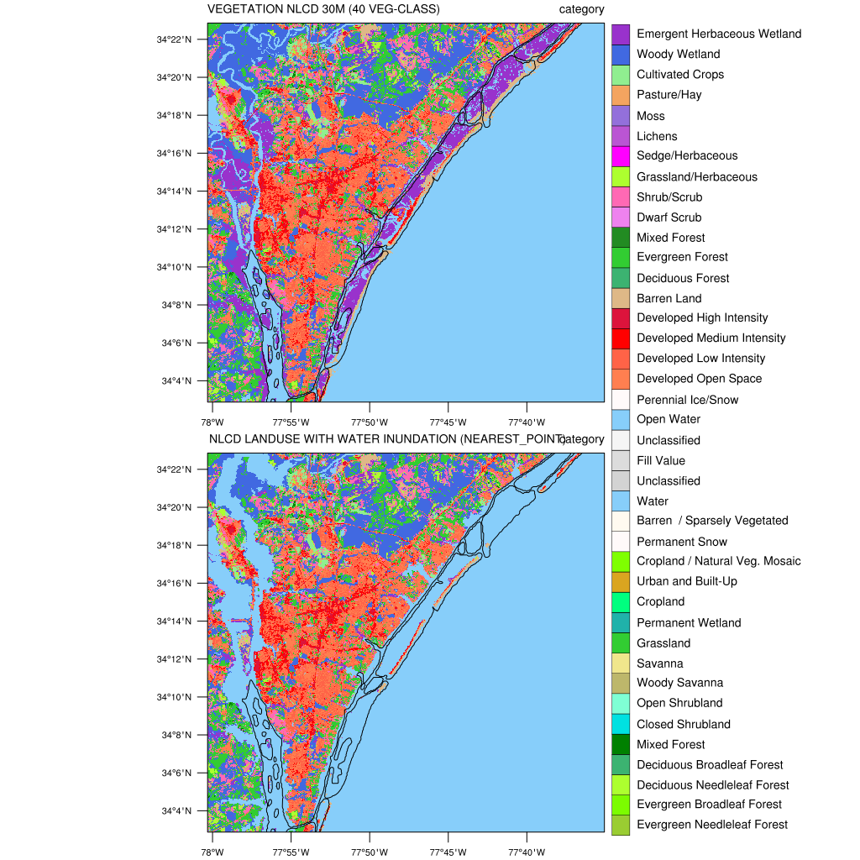
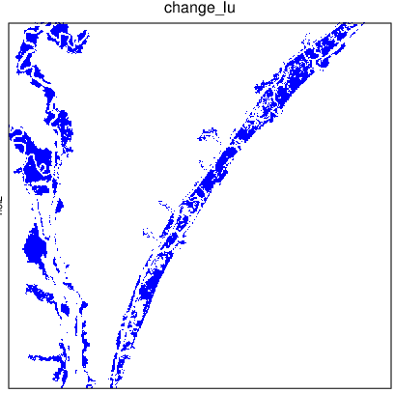
DOMAIN 3 ( 30 meters Resolution)

Slide 13
DUAL RADAR DOPPLER DATA - FLORENCE 2018 case
Wind Speed dataset
Dual-Doppler analyses for the landfall of Hurricane Florence observed by the Shared Mobile Atmospheric Research and Teaching Radar 3 (SR3) and the WSR-88D near Wilmington, NC (KLTX).
netcdf DDA_0904_1.0 {
dimensions:
NX = 200 ; (in km)
NY = 175 ; (Km)
NZ = 20 ; (m) 500, 1000, 1500, 2000, 2500, …., 10000
variables:
double X(NX) ;
double Y(NY) ;
double Z(NZ) ;
double U(NX, NY, NZ) ; east-west U wind (m/s)
double V(NX, NY, NZ) ; north-south V wind *m/s)
double W(NX, NY, NZ) ; vertical wind (m/s)
double CVG(NX, NY, NZ) ; Coverage array (1 – good data; 0 – bad data)
double CVG2(NX, NY, NZ) ; extra coverage area
double MAXDBZ(NX, NY, NZ) ; Max reflectivity
}
If we want records of 10m wind speed with 90% accuracy, we should not compare model output with estimations of 10m wind speeds - the estimations of 10m wind speed based on radar data might not even be 90% accurate to the actual 10m wind speed (powell et al 2009)

Slide 14
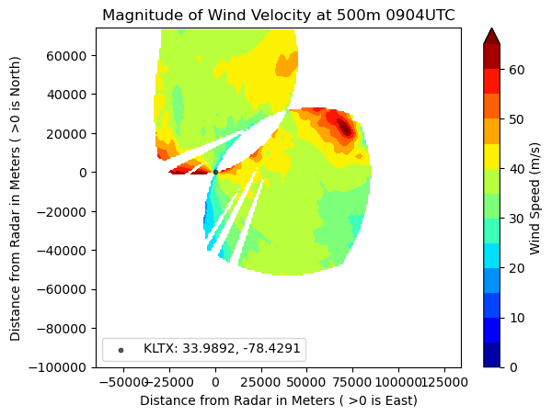
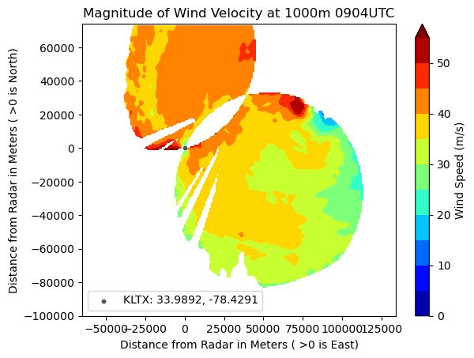
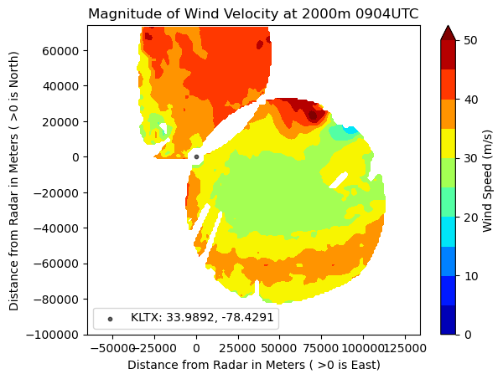
Dual Doppler Radar Wind speed at different
height and coverage area
0904 UTC 14 Sep 2018 (at Landfall)
500m
1000 m
2000 m
After adding Lat and Lon with this data we can create map coastlines.

Slide 15
RADAR REFLECTIVITY COMPARISON OBSERVED RADAR & HWRF AND Downscaled LES

Slide 16
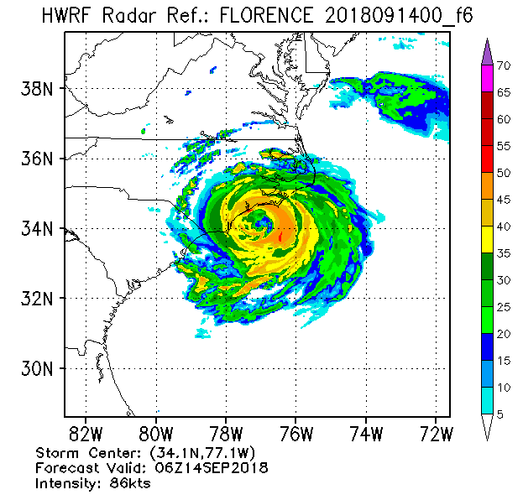
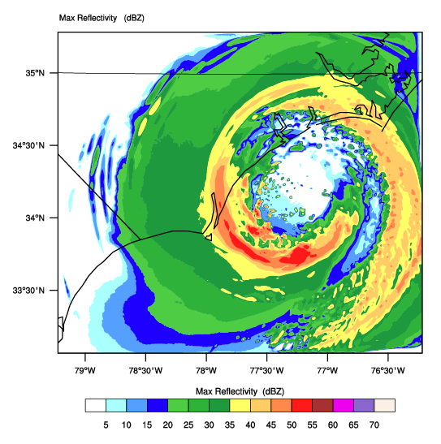
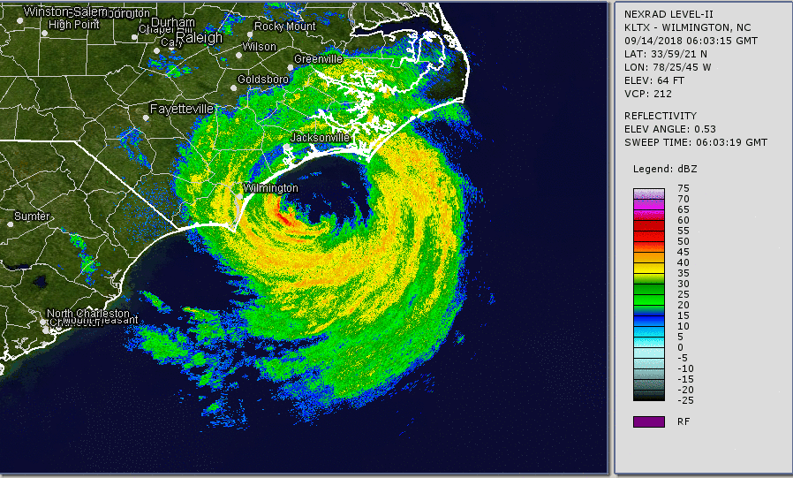
RADAR REFLECTIVITY COMPARISON
HWRF, OBSERVED RADAR, LES
06 UTC 14 Sep 2018
HWRF
RADAR
LES

Slide 17
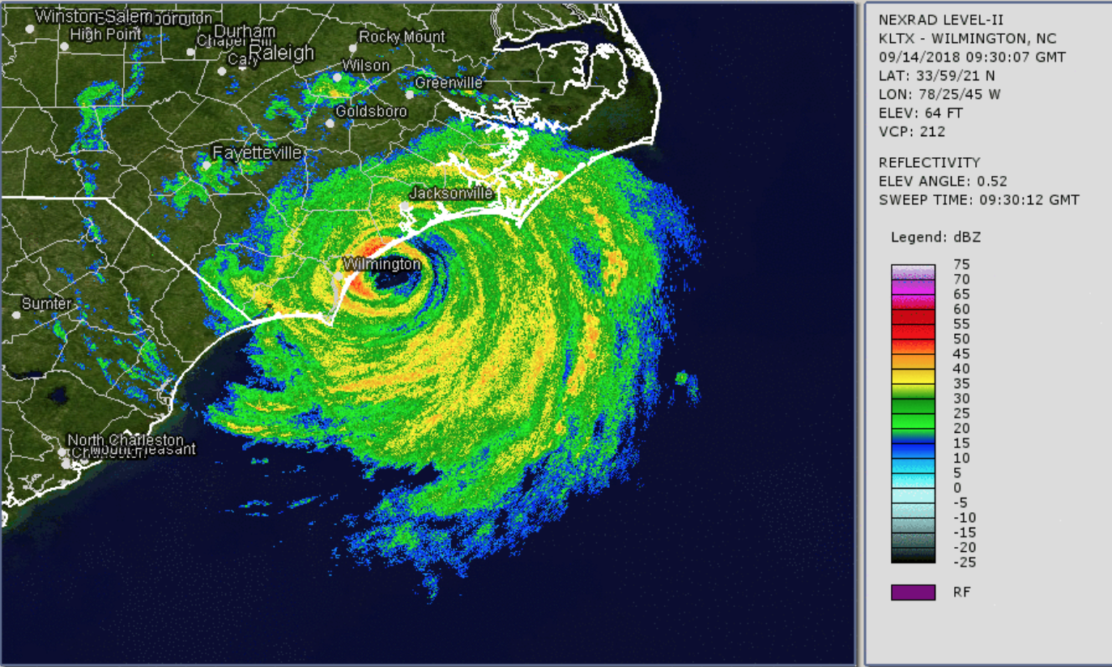
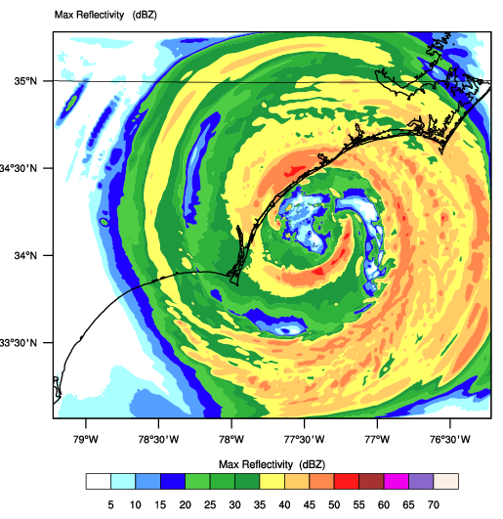
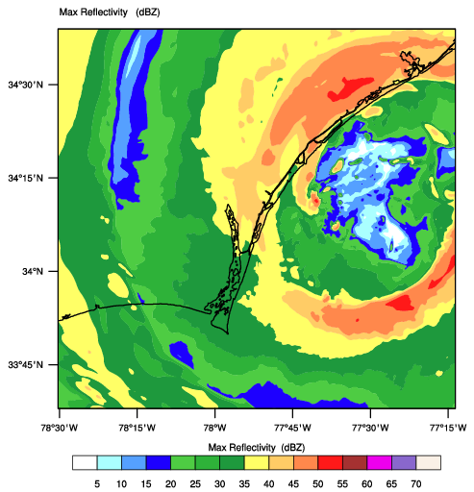
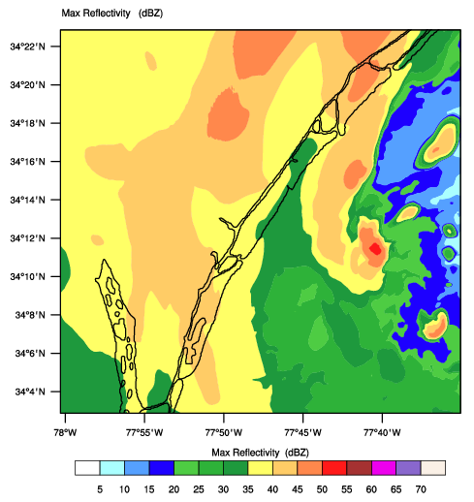
D01 – 400m
D02 – 90m
D03 – 30m
NWS RADAR 0930 UTC
RADAR REFLECTIVITY COMPARISON
NWS RADAR WITH LES SIMULATED REFLECTIVITY
0930 UTC 14 Sep 2018
(at Landfall)

Slide 18
VALIDATION OVER STATIONS Wind Speed, Wind Gust, Wind Direction, Surface Pressure & TTEST (WIND SPEED) Scatter 90% accuracy

Slide 19
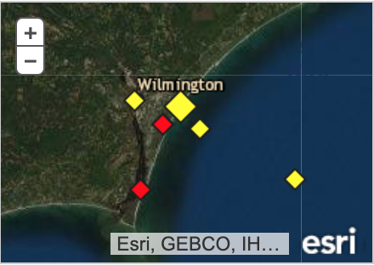
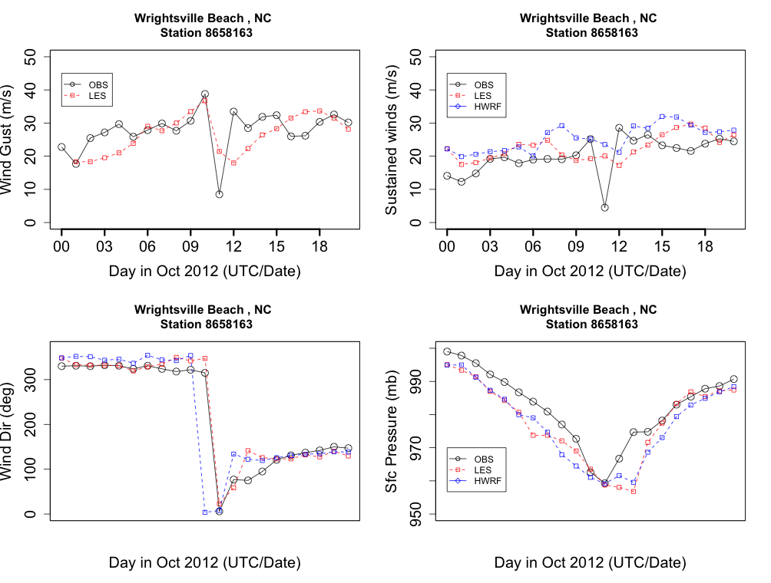
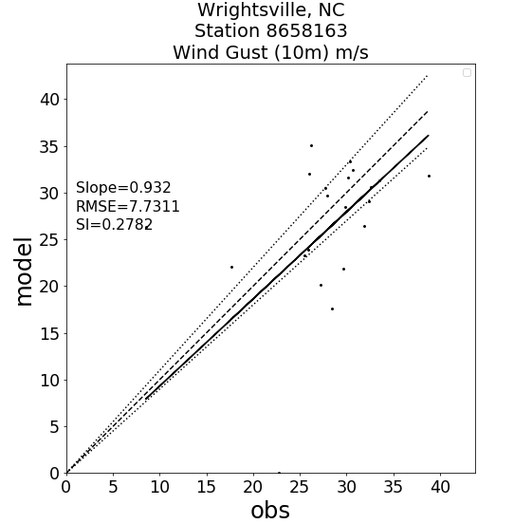
Wrightsville Beach, NC : Station: 8658163

Slide 20
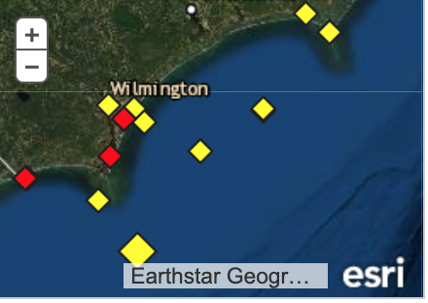
Station | 90% Accuracy
8656483, Beaufort, NC | 86%
CLKN7 Cape Lookout, NC | 92%
8658163, Wrightsville Beach, NC | 93%
41038, Offshore Buoy | 99%
41013 Buoy | 92%
KILM (Wilington Int Airport) | 88%
Average over stations | 91.6%

Slide 21
CONCLUSIONS
Developed a Wind downscaling framework using HWRF/URMA & Storm surge inundation data
High-resolution Land use (30m) and topography (10m) data
Urban physics included to address coastal cities urban effects
Hurricane Ike (2008), Irma (2017), (Sandy (2012) Hurricane Florence (2018) case presented
Next Storms: Lane (2018) & Michael (2018)- 10 storms in total must be evaluated.
90% validation & CONOPS development (ongoing)
90% accuracy is challenging and LES model results are very sensitive to initial and boundary conditions. Forcing fields must be accuracte enough to get 90% accuracy in LES outputs.
Future considerations include:
Refine wind downscaling component if needed.
Integration with national water model.
Consider coupling wave/surge in the LES step: desirable? feasible?

Slide 22
THANK YOU!
Contact: anil.kumar@noaa.gov

